Slide 1

Data Engineering Project 3 | Group 1

Slide 2

Index
Data & methodology
Key Observations
ERD & ETL
TABLES
Data Retrieval
Summary & next steps

Slide 3

DATA & METHODOLOGY

Slide 4

Data and Methodology
Objective
To provide our client with Los Angeles Airbnb data that is comprehensive, organized, easily accessible, and ready for analysis.
Data Source
https://www.kaggle.com/datasets/oindrilasen/la-airbnb-listings
Methods
ERD: Data Transformation Planning
ETL: Data Transformation, Storage & Retrieval
Python
Pandas, NLTK, TextBlob, NumPy
PostgreSQL & SQLAlchemy

Slide 5
Key observations

Slide 6
Key observations
NEEDS UPDATED
Strengthen your familiarity
NEEDS UPDATED
Pacing, tone, and emphasis
NEEDS UPDATED
Aim for seamless, professional delivery
NEEDS UPDATED
Enlist colleagues to listen & provide feedback
NEEDS UPDATE

Slide 7
Erd & ETL

Slide 8
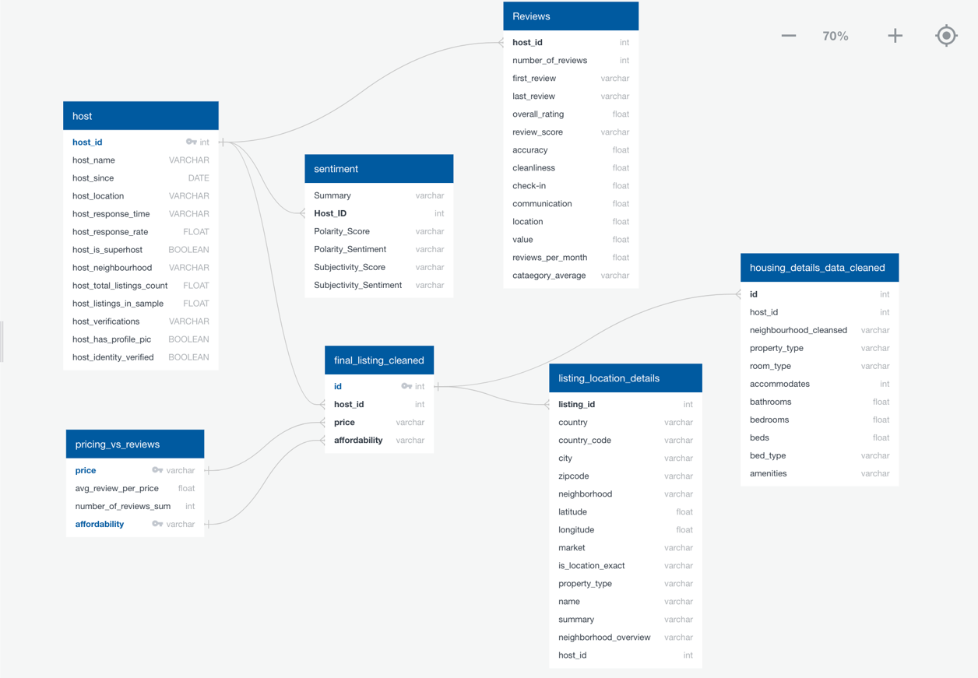
Data retrieval and transformation
Entity Relationship Diagram
Extract | Transform | Load
Original data was extracted from an open-source data set in Kaggle and stored in the project GitHub repository | Using Python (specifically pandas), the data was trimmed, sampled, and organized into several linkable tables addressing different areas of interest | The organized data was inserted in PostgreSQL tables individually, and then joined back into a final, analysis ready dataframe stored using SQLAlchemy

Slide 9
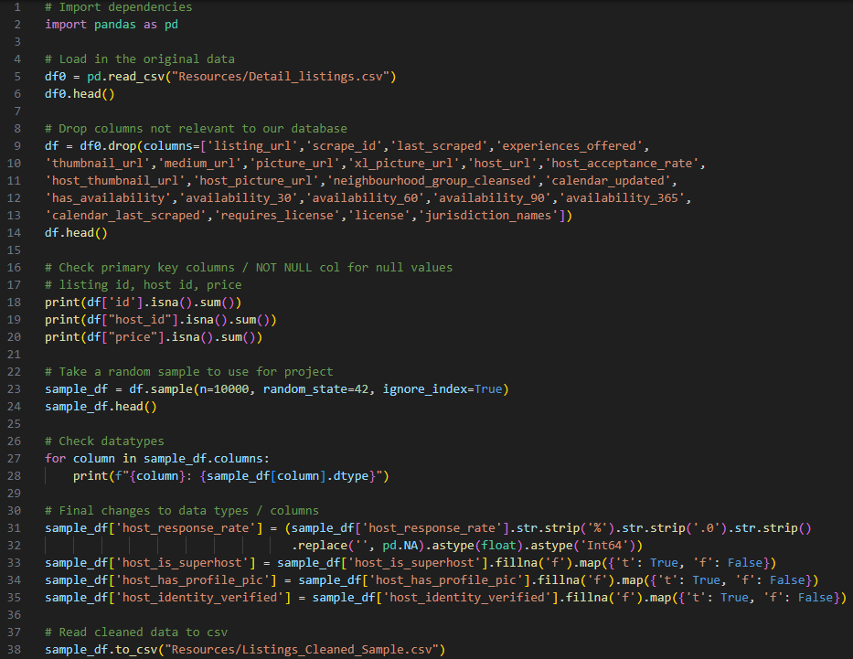
Primary Dataset Creation Truncated for reporting purposes
Notes:
Don’t talk about this, just here for a quick view and move on. NOT INCLUDED IN OUR SPEAKING TIME

Slide 10
tables

Slide 11
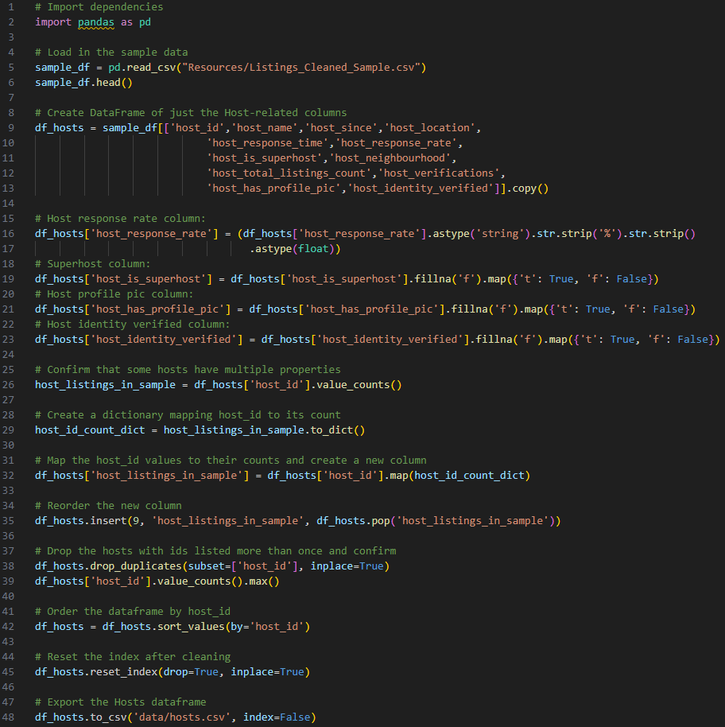
Hosts Truncated for reporting purposes
Notes:
Don’t talk about this, just here for a quick view and move on. NOT INCLUDED IN OUR SPEAKING TIME

Slide 12
hosts
The host table was created by reducing the primary dataset to columns exclusively related to host information.
Hosts Table
NEEDS TABLE IMAGE
Notes:
NEEDS NOTES

Slide 13
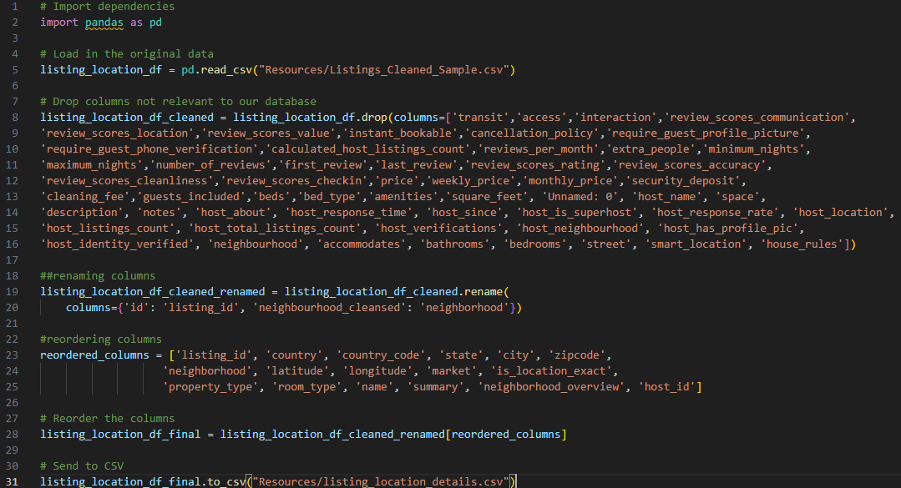
Location Details Truncated for reporting purposes
Notes:
Don’t talk about this, just here for a quick view and move on. NOT INCLUDED IN OUR SPEAKING TIME

Slide 14
Location details
Location details are shown in their own unique table for easy access. The location data was isolated and merged into a PostgreSQL table.
NEEDS TABLE IMAGE
Listing Location Details Table
Notes:
NEEDS NOTES

Slide 15
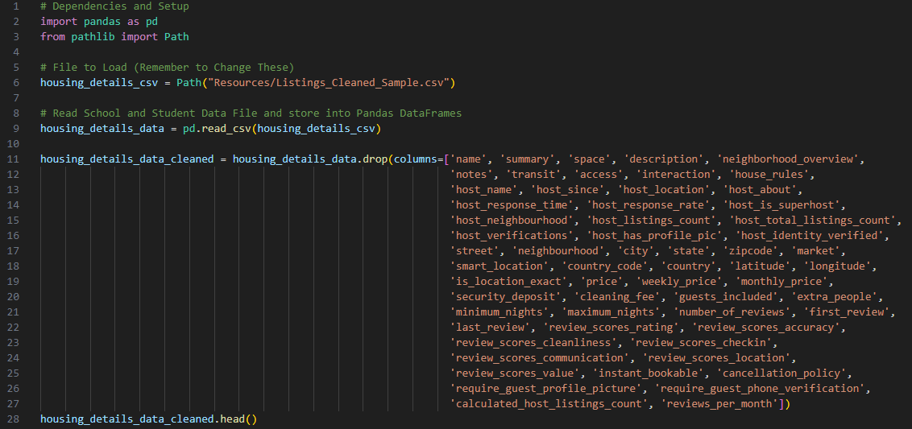
Housing Details Truncated for reporting purposes
Notes:
Don’t talk about this, just here for a quick view and move on. NOT INCLUDED IN OUR SPEAKING TIME

Slide 16
Housing details
Similarly to location, housing details are shown in their own unique table for quick reference. The data was transformed using Pandas and merged into a unique PostgreSQL table.
Housing Details Table
NEEDS TABLE IMAGE
Notes:
NEEDS NOTES

Slide 17
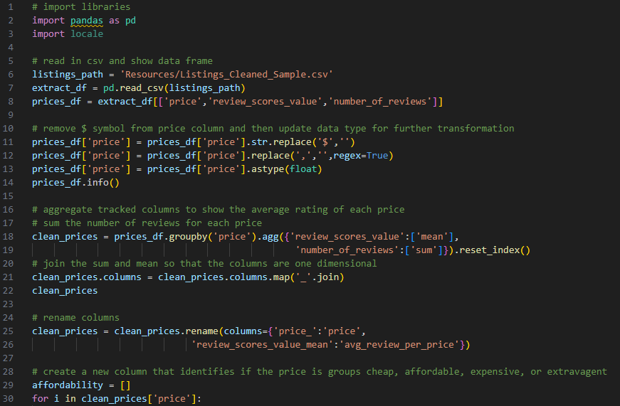
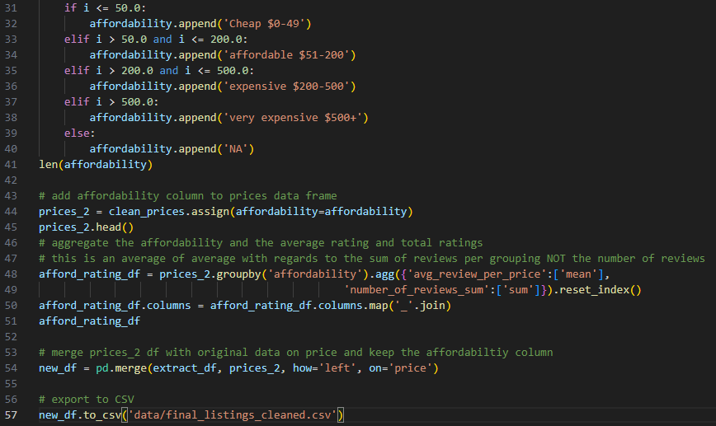
Prices & Reviews Truncated for reporting purposes
Notes:
Don’t talk about this, just here for a quick view and move on. NOT INCLUDED IN OUR SPEAKING TIME

Slide 18
Prices & reviews
The price and reviews table was created by reducing the primary dataset to columns exclusively related to the comparison of pricing and review information. Prices were aggregated by affordability (from cheap to very expensive), average rating, and total rating.
Prices and Reviews Table
NEEDS TABLE IMAGE
Notes:
NEEDS NOTES

Slide 19
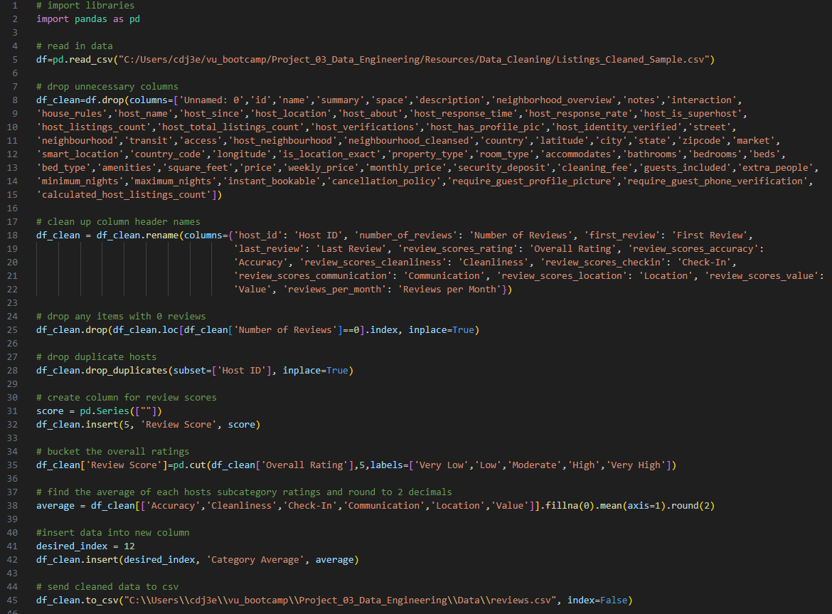
Comprehensive Reviews Truncated for reporting purposes
Notes:
Don’t talk about this, just here for a quick view and move on. NOT INCLUDED IN OUR SPEAKING TIME

Slide 20
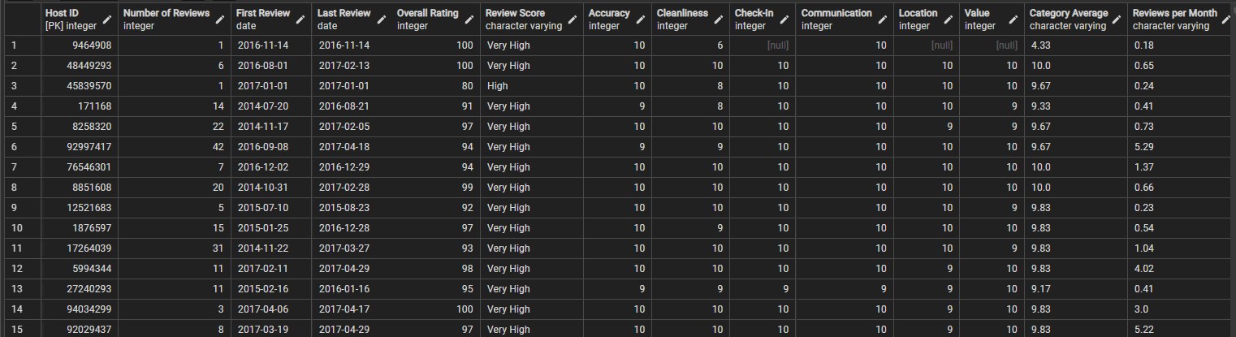
Comprehensive reviews
The comprehensive reviews table was created to provide easy comparison of both overall ratings and host ratings for specific factors. We also created columns for overall review score (from very high to very low) and the average rating across all specific review factors.
Comprehensive Reviews Table
Notes:
NEEDS NOTES

Slide 21
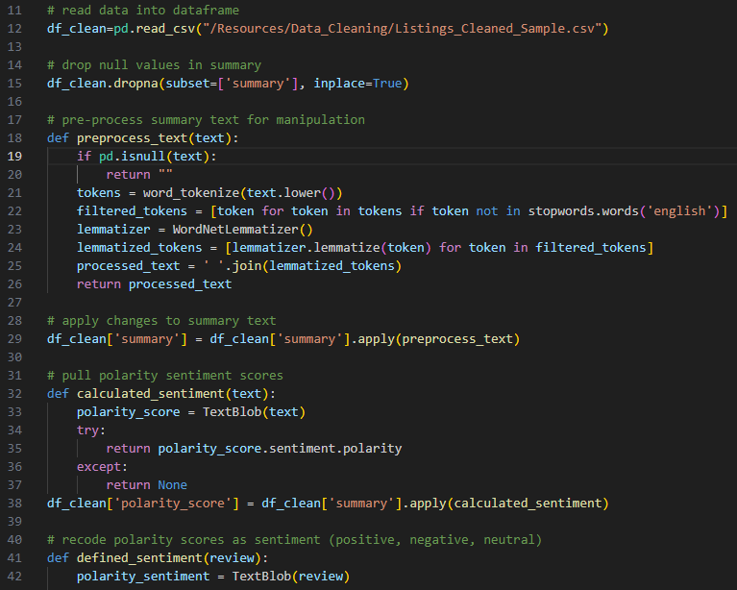
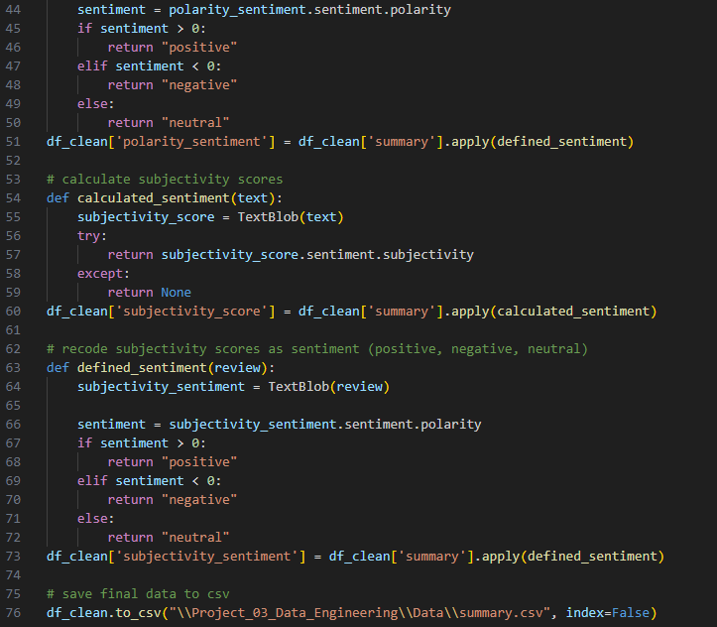
Sentiment Analysis Truncated for reporting purposes
Notes:
Don’t talk about this, just here for a quick view and move on. NOT INCLUDED IN OUR SPEAKING TIME

Slide 22
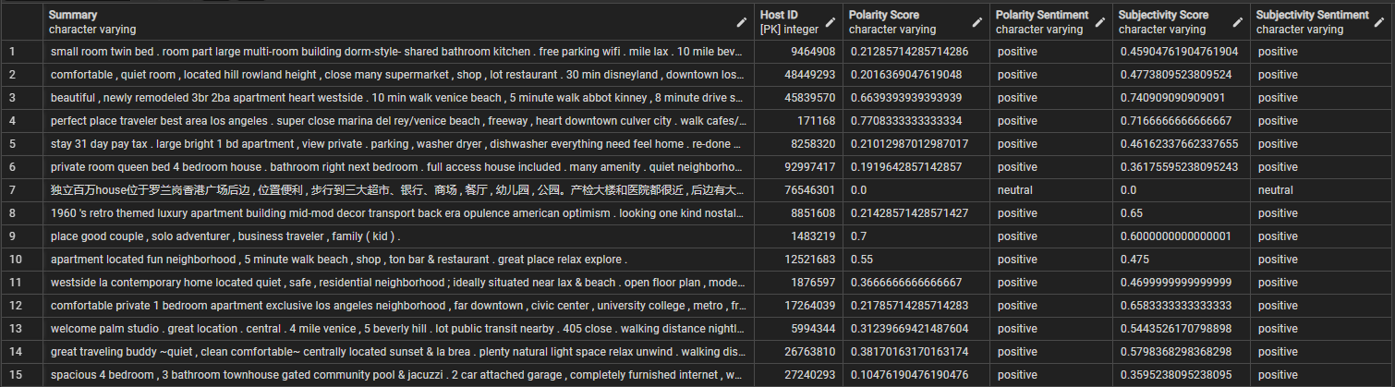
Sentiment analysis
Sentiment analysis was performed on all open-end summary reviews of the Airbnb listings in our sample to reflect if the review was positive, negative, or neutral. The table includes ratings and sentiment for both polarity and subjectivity.
Sentiment Analysis Table
Notes:
NEEDS NOTES

Slide 23
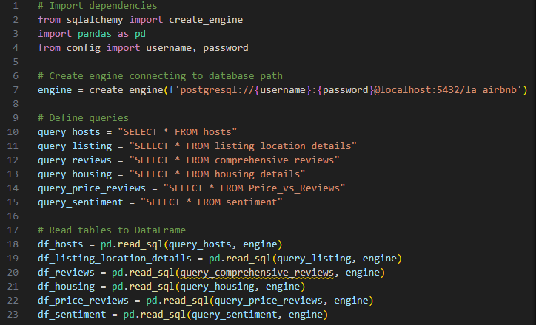
Final Dataframe to PostgreSQL Truncated for reporting purposes
Notes:
Don’t talk about this, just here for a quick view and move on. NOT INCLUDED IN OUR SPEAKING TIME

Slide 24
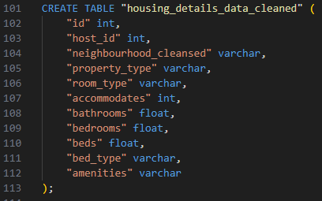
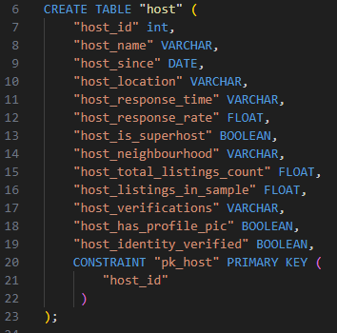
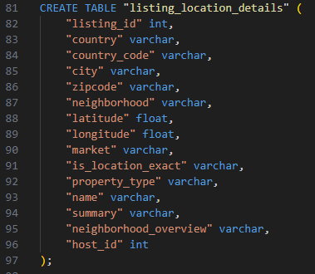
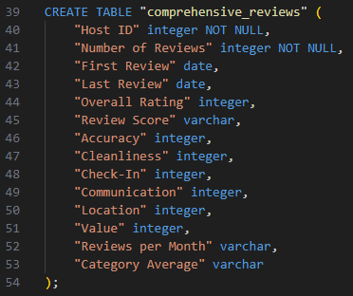
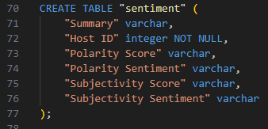
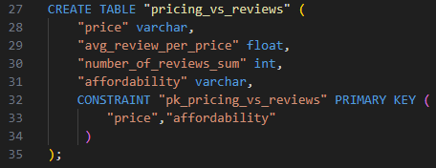
Final dataframe
Our final, analysis-ready dataframe was created by using SQLAlchemy to merge individual pandas dataframes into PostgreSQL for storage.
Final Tables

Slide 25
Data retrieval

Slide 26
Data storage & retrieval
SQLAlchemy
Pandas DataFrame
Flask API & JSON

Slide 27
Summary & next steps

Slide 28
Next steps
Consistent rehearsal
Strengthen your familiarity
Refine delivery style
Pacing, tone, and emphasis
Timing and transitions
Aim for seamless, professional delivery
Practice audience
Enlist colleagues to listen & provide feedback
Seek feedback
Reflect on performance
Explore new techniques
Set personal goals
Iterate and adapt

Slide 29

THANK YOU
Ben Comfort
Amanda Dunaway
Matt Flanagan
Luis Martinez
Charity Ovando

